Slide 1
Analysis Of Skills Required For A Data Scientist Using Machine Learning
Presented by:
DUMPALI SHARATH CHANDRA REDDY

Slide 2

PRESENTED BY: PROJECT SUPERVISOR: Dr. T. Prem Jacob DUMPALI SHARATH CHANDRA REDDY REGISTER NUMBER: 39110291 BRANCH: B.E. CSE SECTION: A5

Slide 3
COURSE CERTIFICATE

Slide 4
OUTLINE
INTRODUCTION
OBJECTIVE
DATA
MACHINE LEARNING APPROACHES
VISUALIZATION OF GRAPHS
SOFTWARE REQUIREMENTS
CONCLUSION

Slide 5
INTRODUCTION
The Data Scientist role demands a person to be a jack of many skills. This information can be used to gain insights such as the key skills and tools required and which degree is preferred the most and the categorization of different roles based on the key skills, etc. This information of 7,000 data scientist jobs around the U.S is collected from Indeed website. The information collected consists of: Company Name, Position Name, Location, Job Description, and Number of Reviews of the Company.

Slide 6
OBJECTIVE
You will be able to know how to pre-process/clean the data using different data preprocessing techniques.
You will able to analyze or get insights into data through visualization.
Applying different algorithms according to the dataset and based on visualization.
You will be able to know how to build a web application using the Flask framework.
You’ll be able to understand the problem to classify if it is a regression or a classification kind of problem.

Slide 7
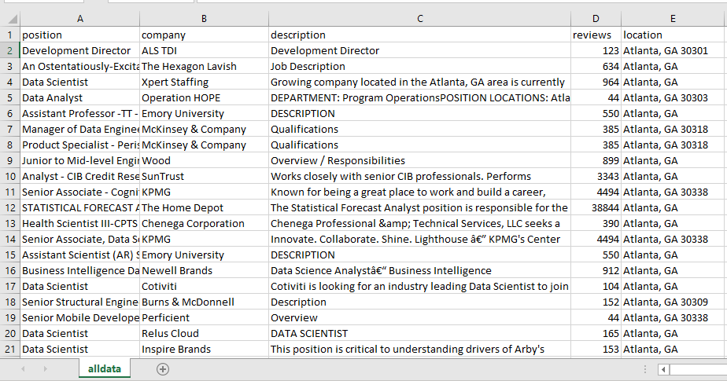
DATA
Analysis Of Skills Required For A Data Scientist
Data set consist of :
6964 rows and 5 columns
Position
Company
Description
Reviews
Location

Slide 8
DATA VISUALISATION
Data visualization is where a given dataset is presented in a graphical format. It helps the detection of patterns, trends and correlations that might go undetected in text-based data. Understanding your data and the relationship present within it is just as important as any algorithm used to train your machine learning model. Machine learning models will perform poorly on data that wasn’t visualized and understood properly.
To visualize the dataset we need libraries called Matplotlib and Seaborn. The Matplotlib library is a Python 2D plotting library that allows you to generate plots, scatter plots, histograms, bar charts etc.

Slide 9
MODEL BUILDING
There are several Machine learning algorithms to be used depending on the data you are going to process such as images, sound, text, and numerical values. The algorithms that you can choose according to the objective that you might have it may be Classification algorithms are Regression algorithms.
Example:
1.Linear Regression
2.Logistic Regression
3. Random Forest Regression / Classification.
4. Stochastic Gradient Descent Regression / Classification.
You will need to train the datasets to run smoothly and see an incremental improvement in the prediction rate.
On our Dataset , we have applied Stochastic Gradient Descent Regression / Classification.
to predict the Accuracy.

Slide 10
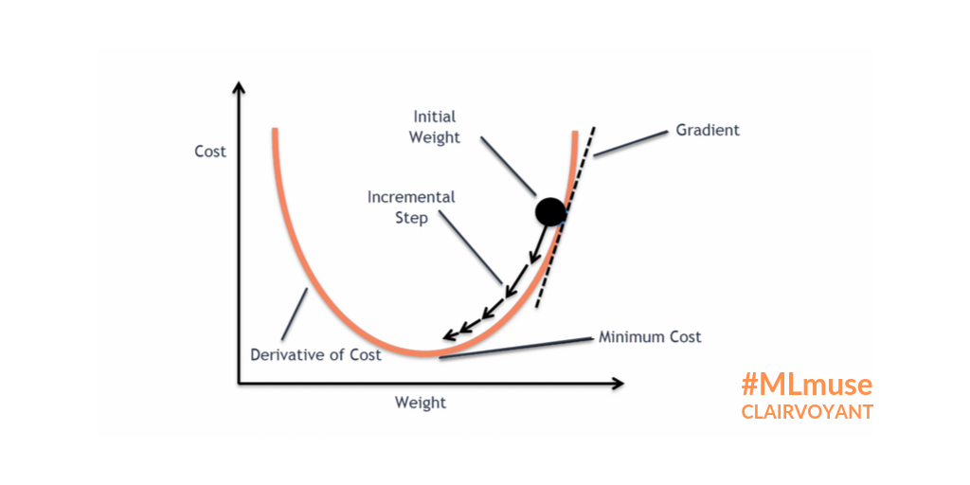
MACHINE LEARNING ALGORITHMS
Stochastic Gradient Descent Regression :
The name Stochastic Gradient Descent - Classifier (SGD-Classifier) might mislead some user to think that SGD is a classifier. But that’s not the case! SGD Classifier is a linear classifier (SVM, logistic regression, a.o.) optimized by the SGD.
Stochastic gradient descent is widely used in machine learning applications.
Out of all the algorithms SGD Regression got the highest accuracy .
So, We build a model with SGD Regression.

Slide 11
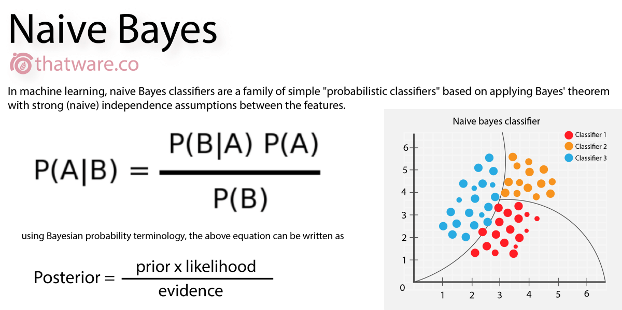
NAIVE BAYES CLASSIFIER :
Naïve Bayes algorithm is a supervised learning algorithm, which is based on Bayes theorem and used for solving classification problems. ... Naïve Bayes Classifier is one of the simple and most effective Classification algorithms which helps in building the fast machine learning models that can make quick predictions.
.

Slide 12
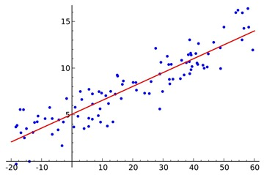
LOGISTIC REGRESSION:
Logistic regression is a supervised learning classification algorithm used to predict the probability of a target variable. The nature of target or dependent variable is dichotomous, which means there would be only two possible classes. ... Mathematically, a logistic regression model predicts P(Y=1) as a function of X.
Logistic Regression is used when the dependent variable (target) is categorical. For example,
To predict whether an email is a spam (1) or (0)
Whether the tumor is malignant (1) or not (0)

Slide 13
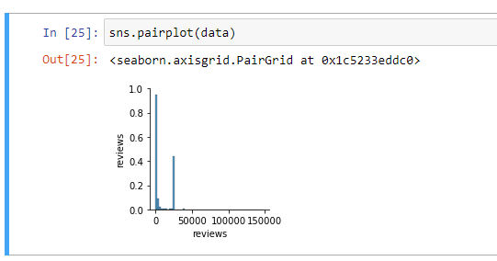
VISUALISATION OF GRAPHS
Pair plot usually gives pair wise relationships of the columns in the dataset From the above pair plot we infer
Position,company,descripition,reviews,location

Slide 14
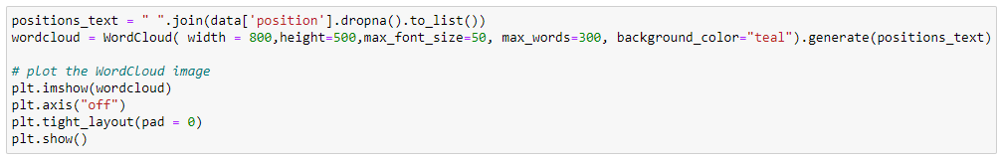
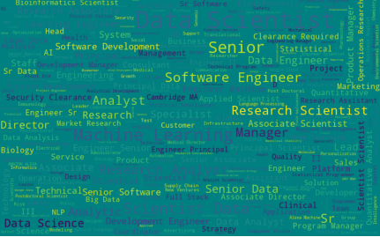
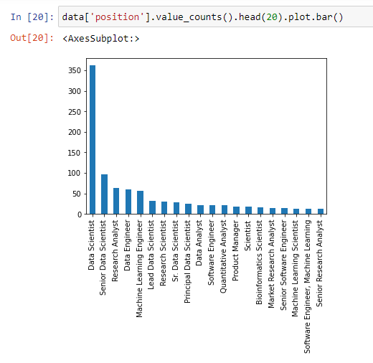

Slide 15
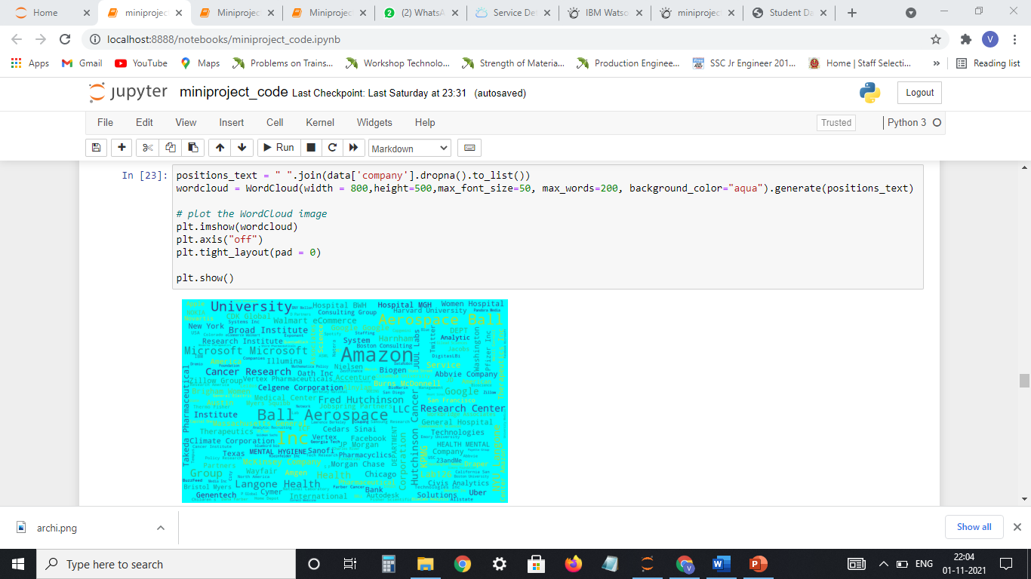
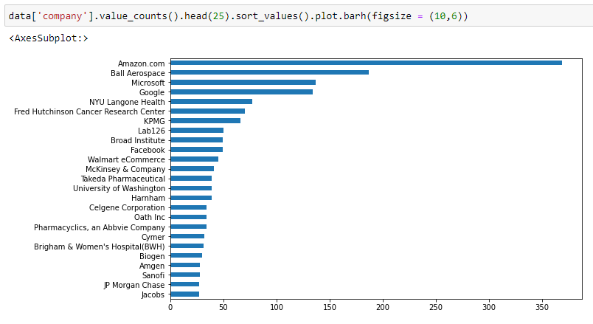

Slide 16
IBM WATSON STUDIO
IBM Acquired soft layer, a public cloud platform, to serve as the foundation for its IaaS offering. In October 2016, IBM rolled the soft layer brand under its Blue mix brand of PaaS offerings, giving users to access both IaaS and PaaS resources from a single console. IBM cloud provides a full-stack, public cloud platform with various products in the catalog, including options for compute, storage, networking, end to end developer solutions for app development, testing and deployment, security databases, and cloud native services.
We Created the IBM cloud account by going to the IBM cloud login page. Then we login to IBM Watson Studio and deployed our model on IBM.
Advantages of deploying model on CLOUD:
Security and privacy. Much like a private cloud, you can ensure your data remains secure when you are the only organization that uses the private portion of your infrastructure.
Potential cost savings.
Superior flexibility and scalability.

Slide 17
SOFTWARE REQUIREMENTS
Anaconda navigator
Jupyter notebook
Machine learning tools: pandas,
NumPy,
Matplotlib,
Scikitlearn,
Seaborn,
wordcloud

Slide 18
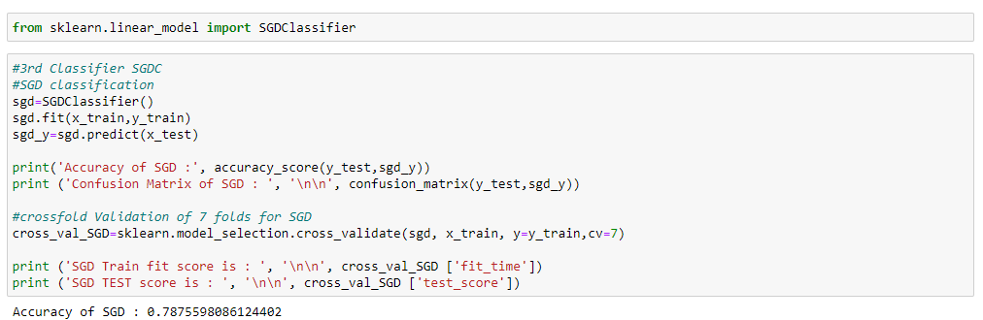
CONCLUSION:
In this project we have presented the Analysis of skills required for a Data Scientist.
We have done the Prediction using Machine Learning Techniques.
For the better results we used Stochastic Gradient Descent algorithm and proved with 78% accuracy.

Slide 19
THANK YOU

